Slide 1
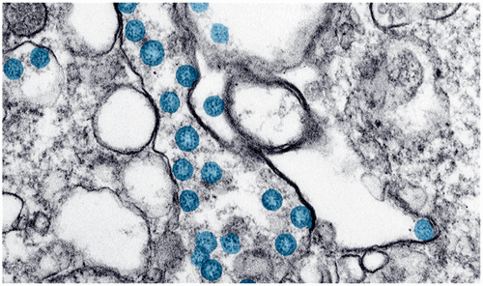
How much we know about the invisible Enemy ? COVID-19
Quazi Tarikul Islam
Professor of Medicine
Member, National Technical Advisory Committee on COVID-19
prof.tarik@gmail.com prof.tarik@gmail.com

Slide 2
Contents
IPC
Long COVID Care
Vaccines
Pitfalls/ Fictions/Facts
Physician’s Wellbeing

Slide 3
Infection Prevention & Control in Health care settings during COVID-19 pandemic

Slide 4
IPC measures
Hand Hygiene
Mask
Social Distancing

Slide 5
IPC
Infection prevention and control (IPC) is the practice of preventing or stopping the spread of infections during healthcare delivery in facilities like hospitals, dialysis centers, long-term care facilities or traditional practitioners.
In the context of COVID-19, the IPC goal is to support the maintenance of essential healthcare services by containing & preventing COVID-19 transmission within healthcare facilities to keep patients & healthcare workers healthy & safe.
Notes:
IPC is a critical part of health system strengthening and must be a priority to protect patients and healthcare workers.

Slide 6
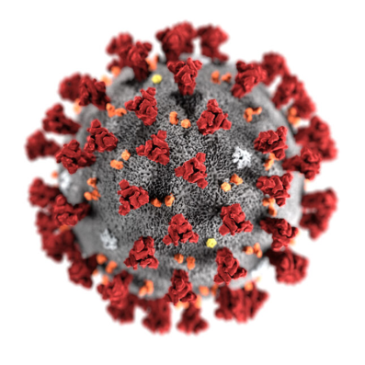
IPC strategies in Health Care Settings
1. Ensuring triage, early recognition, and source control
2. Applying standard precautions for all patients
3. Implementing empiric additional precautions
Contact and droplet precautions
Airborne precautions for aerosol-generating procedures
4. Implementing administrative controls
5. Using environmental and engineering controls

Slide 7
1. Triage, early recognition and source control
Triage: A system for assessing all pts at admission for
early recognition of possible COVID 19
immediate isolation of pts in area separate from other pt (source control)
Well equipped triage station at the entrance
Use screening questionnaires according case definitions

Slide 8
Mild to Moderate
Home treatment
Moderate to Severe
Likely needs O₂
Severe to Critical
Probably needs ICU

Slide 9
2. Standard precaution for all patients
Hand hygiene
Respiratory hygiene
Appropriate PPE according to risk assessment
Safe waste management
Cleaning & disinfection of patient care equipment & linen
Cleaning and disinfection of environment

Slide 10
“My 5 moments for Hand Hygiene”

Slide 11
Hand Wash

Slide 12
Hand rubbing needs 20-30 seconds
Step 1: Apply the alcohol-based hand sanitizer in a cupped hand (2 ml), covering all surfaces
Step 2: Rub hand palm to palm
Step 3: Right palm over left dorsum with interlaced fingers and vice versa
Step 4: Palm to palm with fingers interlaces
Step: 5 Backs of fingers to opposing palms with Fingers Interlocked
Step 6: Rotational rubbing of left thumb clasped in right palm and vice versa
Step 7: Rotational rubbing, backward and forward with clasped fingers of right hand in left palm and vice versa
Step 8: Dry your hand in air

Slide 13
Hand Rub
Notes:
ABHR 60 to 80% , 20 to 30 sec

Slide 14
Respiratory Hygiene/cough etiquette
Display graphic information
Perform hand hygiene after contact with resp sec, or objects contaminated with resp sec
Medical masks to all patients & their attendants
Notes:
About coughing or sneezing etiquette

Slide 15
MEN

Slide 16
Person with respiratory signs and symptoms
Wear surgical mask in public place specially when coughing/sneezing
Dispose used tissues and masks in yellow waste bin
Perform hand hygiene after contact with respiratory secretions
In case of sudden episode, use upper arm during coughing and sneezing
Turn your head away from people/patients or food while sneezing or coughing

Slide 17
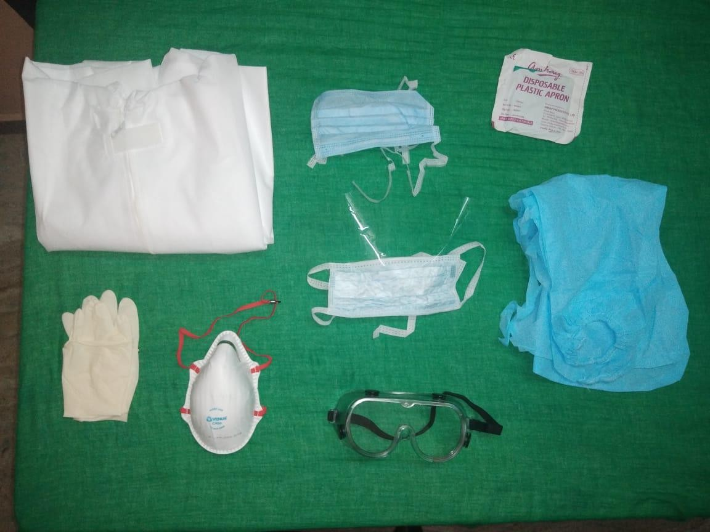
Personal Protective Equipment
Objectives:
Protect skin and mucous membrane of HCW
Protect the pt from contacting infection
Selection of PPE (type of exposure, isolation precaution, fit etc)
Types of PPE ( Gown/apron, mask/respirator, goggles/face shield/ gloves/ shoe cover)

Slide 21
PPE

Slide 22
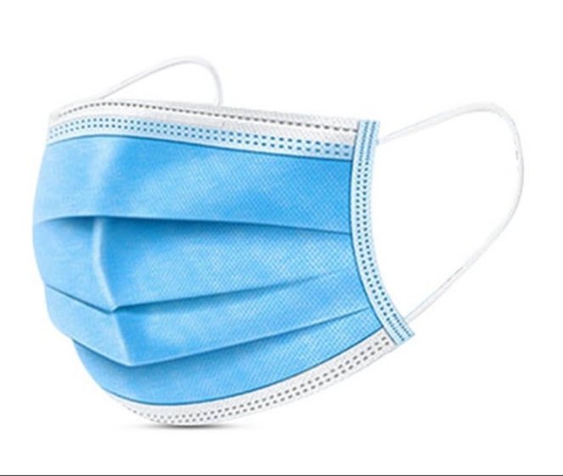
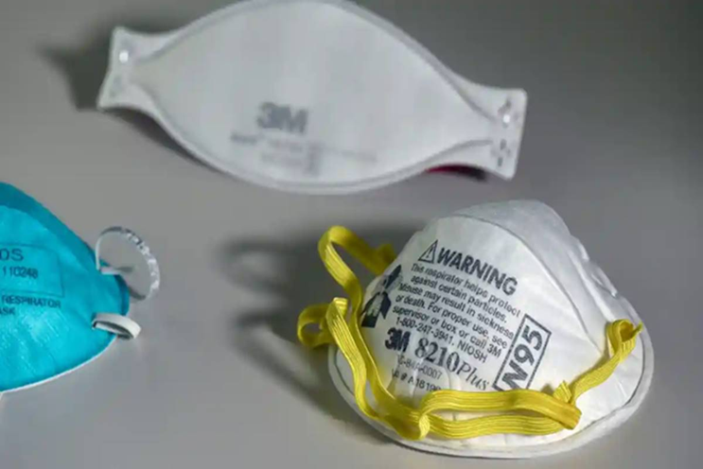
Universal masking
Targeted continuous medical mask use

Slide 23
Correct way of wearing MASK

Slide 25
MEASURES SHOULD BE CONSIDERED WHILE USING SURGICAL MASKS
Should be single use and never be reapplied
Should not be left dangling around the neck
Touching the front of the mask should be avoided
Avoid talking, coughing or sneezing
Perform hand hygiene before donning, upon touching or discarding an used mask
Should be changed after 4-6 hours of use
Should not be shared with others

Slide 26
Effectiveness of PPE
The effectiveness of PPE strongly depends on:
Staff training on putting on & removal of PPE
Prompt access to sufficient supplies
Appropriate hand hygiene
HCWs compliance
Regular monitoring & feedback by IPC personnel
Notes:
The rational & correct use of PPE reduces exposure to pathogen

Slide 27
Sanitation, & Waste management in COVID-19
Separate flush toilet/latrine
Flushed with lid down
Cleaned & disinfected at least twice daily by trained cleaner wearing PPE
Bedpan : excreta disposal→ cleaning with neutral detergent & water → disinfect with 0.5% Chlorine sol → rinse with clean water
Diaper: disposed as infectious waste
Notes:
Lid down to prevent droplet splatter & aerosol clouds
Heavy duty gloves & boots
Separate toilet for HCW
Chlorine can not disinfect large amounts of solid & dissolved organic matter
Feces must be treated as biohazard

Slide 28
Waste Disposal
Keep waste in biohazard bag/waste bag in wastes bins
Close/secure waste bag when two third to be filled up
Record of generated wastes in designated temporary storage areas before disposal
Treat the wastes by chemical decontamination (0.5% sodium hypochlorite) or autoclave;
Wash used linen (apron, hospital gown, sheets and cotton blankets) in hot water (70°C to 80°C) with detergent and after that can soak in 0.1%NaOCL for 30 min then wash with water
Manage wastes by incineration (ideal), if not available, do burning
− Burning waste in burial pits (>8 feet deep) in premises, behind the hospital building

Slide 29
Burial Pit

Slide 30
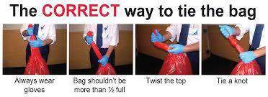
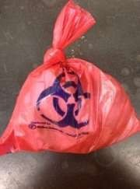
Waste bag

Slide 31
Waste disposal Containers

Slide 32
Waste Disposal

Slide 33
All surfaces should be routinely cleaned & disinfected frequently (at least once a day), & after a patient being discharged
1st with detergent & water
70% ethyl alcohol for small surface areas & equipment
Sodium hypochlorite (0.1% for surfaces & 0.5% for spilled blood/ body fluids)
Exposure time
Notes:
Efficacy of all disinfectants is affected by organic material
Contact time of 1 min is recommended for ethanol, chlorine based products & >0.5% H2O2

Slide 34
Any equipment of the isolation/COVID ward is potentially contaminated.
Pts’ chart, clipboards etc should be kept at working station, not in ward/near pt.
Minimum HCWs during round; keep the round short at bed side, discuss & review pts’ data outside the ward.
Notes:
So, pt’s chart, clipboard

Slide 35
Appropriate disinfectants
Type of disinfectants/decontaminants are:
Soap, detergent,
0.5% sodium hypochlorite solution, (Chlotech, chlorox)
Bleaching solution
70% ethanol
Lysol
Phenolic compound (e.g. Finish)
2% Glutaraldehyde ( Cidex )

Slide 36
Linen
Soiled linen→ leak proof bag→ covered bucket
Machine washing with warm water @ 60⁰-90⁰C & laundry detergent
Soaked in hot water & soap in a large drum with a stick→ soaked in 0.05% Chlorine for 30 min→ rinsed with clean water→ dry
Blood/body fluids/excreta in linen/floor:
Soaked with Na hypochlorite sol
Cleaning followed by disinfection
PPE: appropriate PPE
Reusable: cleaned with soap & water→ decontaminated with 0.5% sodium hypochlorite sol→ rinsed with clean water
Single use: infectious waste
Notes:
Stick to stir
Take care to avoid splashing
Dry preferably in sunliht

Slide 37
Safe management of a Dead body
Standard precaution for the personnel who interact with the body (Hand hygiene, gloves, gown).
Ensure that any body fluids leaking from orifices are contained.
Family & friends may visit the body accordance to customs.
During preparation/burial, presence of minimum number of persons.
Notes:
HCW, mortuary stafff, burial team

Slide 38
3. Transmission based precaution
Pts should be placed in adequately ventilated room with natural ventilation.
Pts’ beds should be placed at least 1 meter apart.
HCWs should wear appropriate PPE.
Notes:
Additionally, adequately ventilated single rooms or wards are suggested. For general ward rooms with natural ventilation, adequate ventilation for COVID-19 patients is considered to be 60 L/s per patient. When single rooms are not available, suspected COVID-19 patients should be grouped together with beds at least 1 meter apart based on WHO’s recommendation, although some member states have recommended maintaining greater distances whenever possible

Slide 39
Disposable or dedicated patient care equipment should be used. If necessary, then it should be cleaned & disinfected between use for each patient.
Designated & dedicated cohort of healthcare workers to care for patients with COVID-19.
Transportation of patients with COVID-19 should be avoided unless medically necessary.
Notes:
If it is medically necessary to transport a patient, place a mask on the suspected or confirmed COVID-19 patient. Healthcare workers should also wear the appropriate PPE when transporting patients.
Restricting the number of visitors allowed in the facility and rooms is also suggested.

Slide 40
Airborne Precautions
AGPs in an adequately ventilated room
Use of appropriate PPE
Respirators with seal check
Eye protection
Long sleeved gown, waterproof apron
Minimum number of HCWs required for pts’ care
Notes:
Fluid resistant

Slide 41
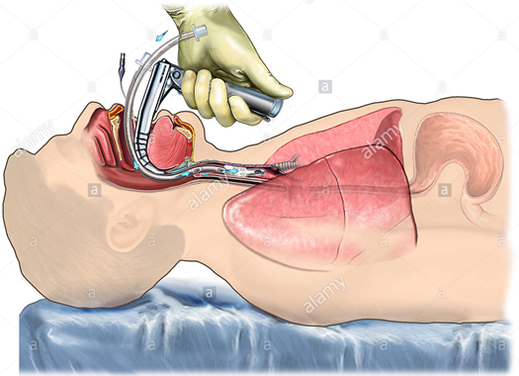
Aerosol Generating Procedures
Tracheal intubation & extubation
Non-invasive ventilation, HFNC
Tracheotomy
CPR
Manual ventilation before intubation
Bronchoscopy
Open suctioning
Nebulization
Sputum induction
NG tube insertion &/or removal

Slide 42
4. Implementing Administrative Control
Establishing sustainable IPC infrastructure & activities
Provision of adequate training for HCWs
Ensuring adequate pt-to-staff ratio
Monitoring compliance
Establishing active syndromic surveillance of HCWs
Educating pts’ caregivers: hand hygiene, resp etiquette, physical distancing etc
Developing policies for early recognition of COVID-19

Slide 43
Preventing overcrowding
Restrict entry
Mask, physical distancing for all
Alternatives for direct interaction
Providing dedicated areas
Ensuring adequate supplies of PPE & others
Ensuring adherence to IPC policies in all aspects of health care

Slide 44
5. Implementing environmental & engineering Control
Ensuring adequate ventilation according to specific areas
Adapted structural design
Spatial separation
Adequate environmental cleaning
Notes:
Glass/plastic barrier

Slide 45
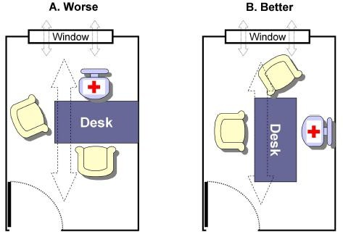
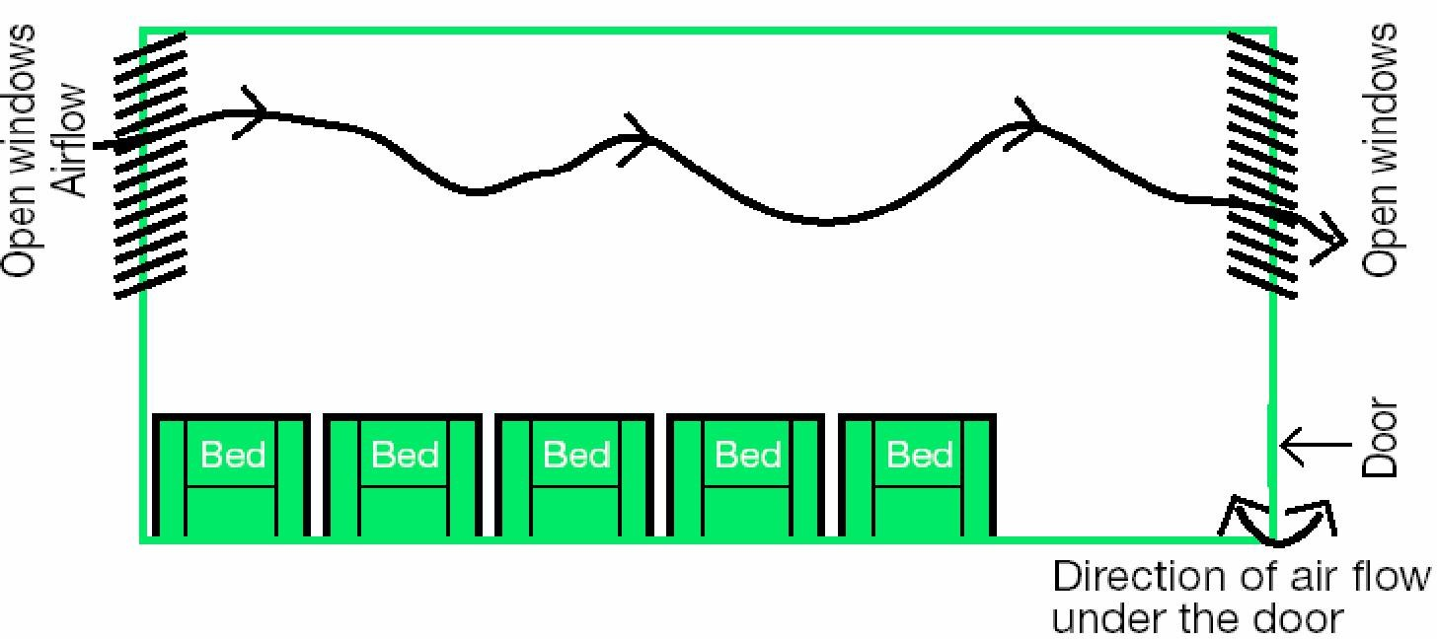
In room (A), the seating arrangement is along with direct of natural ventilation of air flow, so that the doctor has higher risk of exposure to the potentially infected air. In room (B), doctor is sitting away from the direction of natural airflow, thus has lesser risk of exposure
Schematic diagram of a room with natural ventilation

Slide 46
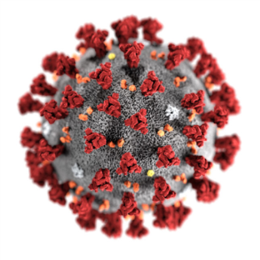
Collecting & Handling Laboratory specimens
All specimens should be regarded as potentially infectious.
Appropriate PPE for personnel who collect samples.
All personnel who transport specimens are trained in safe handling procedure.
Appropriate biosafety practices in laboratories based on WHO’s interim guidance.
Notes:
Glass/plastic barrier

Slide 47
Considerations for Surgical Procedures
Elective surgery should be postponed if possible.
RT-PCR before doing any surgical procedures.
Avoid AGPs if possible.
Minimum staff inside OT.
Notes:
Glass/plastic barrier

Slide 48
Challenge of IPC implementation in Bangladesh
Lack of proper knowledge & trained manpower
Poor administrative support
Not following Institutional SOP
Absence of checklist, supervision & monitoring of IPC practices
Poor environmental cleaning

Slide 49
SUMMERY OF IPC
Contain the infection where it is.
Hand washing/sanitizing at every encounter is a must.
Proper training of all HCWs on proper use of PPE.
Monitoring and evaluation of IPC practices.
No compromise in HCWs’ safety.

Slide 52
REHABILITATION of COVID Survivors
(Long COVID)

Slide 56
Post COVID Health Problem

Slide 61
Neurological Manifestations

Slide 62
Cardiac

Slide 63
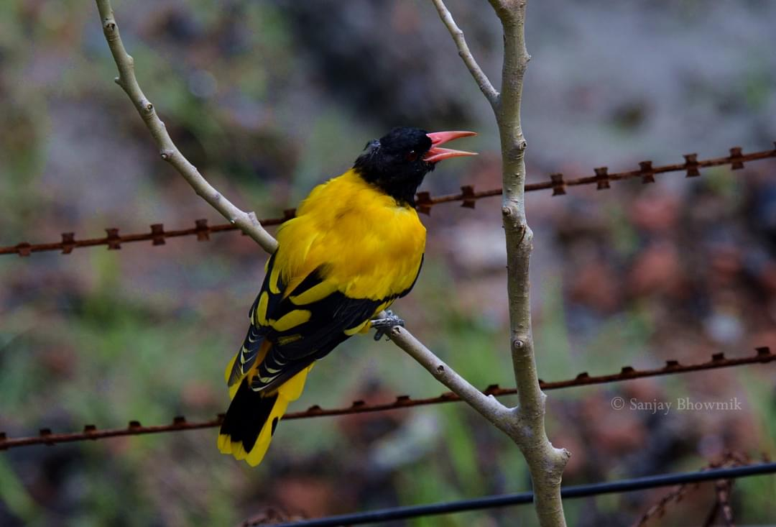
Cardiac Manifestations

Slide 65
COVID-19 Vaccine

Slide 66
Why do we need a vaccine for Covid 19?
Globally, as of 14 September, 2020, there have been 29,281,133 confirmed cases of COVID-19, including 929911 deaths, reported to WHO.
This huge burden of patients and death toll gives us a clear indication of how deadly and devastating this pandemic has turned out to be.
Not only in terms of human loss, its massive penetration has led to substantial hindrance in economic growth worldwide.

Slide 67
What is a vaccine?
A vaccine is a biological preparation used to stimulate the production of antibodies and provide immunity against one or several diseases, contains a agent/s which resembles a disease causing microorganism and is often made from weakened or killed forms of the microbe, its toxins, or one of its surface proteins.

Slide 68
Types of vaccine
Inactivated Vaccine
Live attenuated vaccine
Toxoid
Subunit
Conjugate
Heterotypic
Experimental
Valence

Slide 69
Stages of Vaccine Development
STAGE 01
STAGE 03
Exploratory Stage
Clinical development
STAGE 02
Pre-clinical Stage
Reference: CDC

Slide 70
CLINICAL DEVELOPMENT STAGE
PHASE 1 SAFETY TRIALS: Scientists give the vaccine to a small number of people to test safety and dosage as well as to confirm that it stimulates the immune system.
PHASE 2 EXPANDED TRIALS: Scientists give the vaccine to hundreds of people split into groups, such as children and the elderly, to see if the vaccine acts differently in them. These trials further test the vaccine’s safety and ability to stimulate the immune system.

Slide 71
CLINICAL DEVELOPMENT STAGE
PHASE 3 EFFICACY TRIALS: Scientists give the vaccine to thousands of people and wait to see how many become infected, compared with volunteers who received a placebo. These trials can determine if the vaccine protects against the pathogen. In addition, Phase 3 trials are large enough to reveal evidence of relatively rare side effects that might be missed in earlier studies

Slide 73
Pandemic Vaccine
Regulators in each country review the trial results and decide whether to approve the vaccine or not. During a pandemic, a vaccine may receive emergency authorization before getting formal approval.
Once a vaccine is licensed, researchers continue to monitor people who receive it to make sure it’s safe and effective.
Reference:
The New York Times

Slide 75
Factors Considered During Vaccine Development
Safety
Efficacy
Duration of immunity
Doses (Single or Multiple)
Storage (Normally vaccine can be stored at 4 degree Celsius, but RNA vaccine require -80 degree Celsius)

Slide 76
Vaccine
172 countries and multiple candidate vaccines engaged in COVID-19 vaccine Global Access Facility - WHO
Nine CEPI-supported candidate vaccines are part of the COVAX initiative, with a further nine candidates under evaluation, and procurement conversations on-going with additional producers not currently receiving research and development (R&D) funding through COVAX – giving COVAX the largest and most diverse COVID-19 vaccine portfolio in the world
80 potentially self-financing countries have submitted non-binding expressions of interest to the Gavi-coordinated COVAX Facility, joining 92 low- and middle-income economies that are eligible to be supported by the COVAX Advance Market Commitment (AMC)

Slide 77
Where we are ?
The New York Times/August, 2020

Slide 78
VACCINES IN PHASE 3
Moderna in partnership with NIH.
AstraZeneca, a British-Swedish company in collaboration with the University of Oxford( Unfortunately paused their program)
German company BioNTech in collaborationwith Pfizer, based in New York, and the Chinese drug maker Fosun Pharma
Gamaleya – Russian Company – marketed in their country
Murdoch Children’s Research Institute in Australia

Slide 79
Contd
Wuhan Institute of Biological Products, tested by Sinopharm
Beijing Institute of Biological Products, tested by Sinopharm
Chinese company CanSino Biologics
Sinovac Biotech, a Chinese Private company
Sputnik V , Russia

Slide 80
APPROVED VACCINES
The Chinese company CanSino Biologics developed a vaccine based on an adenovirus called Ad5, in partnership with the Institute of Biology at the country’s Academy of Military Medical Sciences.
It completed its Phase 2 trial successfully in July. However, in an unprecedented move, the Chinese military approved the vaccine on June 25 for a year as a “specially needed drug.” It is currently in Phase 3 trial.

Slide 81
APPROVED VACCINES
The Gamaleya Research Institute, part of Russia’s Ministry of Health, launched a Phase 1 trial in June of a vaccine they called Gam-Covid-Vac Lyo. It is a combination of two adenoviruses, Ad5 and Ad26, both engineered with a corona virus gene.
On August 11, President Vladimir V. Putin announced that a Russian health care regulator had approved the vaccine, renamed Sputnik V, before Phase 3 trials had even begun. President Vladimir Putin has assured the public that it is safe, adding that one of his daughters had taken it as a volunteer and felt good afterwards. Vaccine experts decried the move as risky.
Nevertheless, Vietnam soon agreed to purchase 50 to 150 million doses. Owing to its lack of safety trials, this vaccine will be administered to 18-60 healthy age group at first.
The New York Times

Slide 86
Bangladesh
Bangladesh might get the vaccine free of cost. Countries with a per capita income of less than 4,000 dollars will get the vaccine free of cost and the per capita income of Bangladesh is near about 2,000 dollars, in this context we will get the vaccine free of cost.“. IS THIS A DREAM ?

Slide 87
Bangladesh
Globe Biotech claimed to be the first Bangladeshi company to develop Covid-19 vaccine on 2nd July this year. The company was undertaking preliminary tests with animal modelling at that time with initial positive results on 5 rabbits. However, after trials are complete, it would take another 6 months for the vaccine to be marketed.
At present, the company is maintaining secrecy about their progress, but we can be hopeful about a good news in near future.
Dhaka Tribune

Slide 88
Bangladesh
Beximco Pharmaceutical did a MOU with SERUM Institute of India for taking part in trial and having the vaccine on priority.

Slide 89
Bangladesh
Govt. approves human trial of Chinese Covid-19 vaccine in Bangladesh- Dhaka Tribune Aug 27,2020
icddr,b has been approved to conduct the trial of the vaccine, developed by Sinovac
The government has given approval to the phase 3, or human, trial of a Covid-19 vaccine in Bangladesh, developed by the Chinese company Sinovac Biotech Ltd

Slide 90
India
According to the latest reports, the preliminary results of Phase I clinical trials of Covaxin show that India’s first corona virus vaccine is safe to use.
The vaccine has been jointly developed by Hyderabad based Bharat Biotech in collaboration Indian Council of Medical Research (ICMR) and the National Institute of Virology (NIV).
12 medical institutes across the country were selected to conduct Phase I/II trial of the home grown vaccine.
August , 2020 ,Times of India

Slide 91
A collaboration between Serum Institute of India (SII), Gavi and the Bill & Melinda Gates Foundation announced ensure up to 100 million doses of AstraZeneca or Novavax’s candidate vaccines, if successful, will be available to low- and middle-income economies through the COVAX Facility at just US$ 3 per dose

Slide 92
VACCINE
One thing is for sure, we are well on our way to developing vaccines for people all over the world. The WHO is coordinating global efforts to develop a vaccine, with an eye toward delivering two billion doses by the end of 2021.
Really Tough
WHO Bulletin,August 2020

Slide 93
GAVI/COVAX/AMC
In July the Gavi Board agreed on the 92 economies that will be supported the COVAX Advance Market Commitment (AMC). The full list is as follows:
Lower-middle income: Angola, Algeria, Bangladesh, Bhutan, Bolivia, Cabo Verde, Cambodia, Cameroon, Comoros, Congo, Côte d'Ivoire, Djibouti, Egypt, El Salvador, Eswatini, Ghana, Honduras, India, Indonesia, Kenya, Kiribati, Kyrgyztan, Lao People’s Democratic Republic, Lesotho, Mauritania, Micronesia, Moldova, Mongolia, Morocco, Myanmar, Nicaragua, Nigeria, Pakistan, Papua New Guinea, Philippines, São Tomé and Principe, Senegal, Solomon Islands, Sri Lanka, Sudan, Timor-Leste, Tunisia, Ukraine, Uzbekistan, Vanuatu, Vietnam, West Bank and Gaza, Zambia and Zimbabwe

Slide 94
Challenges to be faced once a vaccine is available
People may not be convinced to take the corona virus vaccine
The virus may mutate, rendering the vaccines ineffective
The immunity from the vaccine may not last long
The challenge in distributing the vaccine
Maintenance of cold chain and preservation
Prioritization of Vaccination according to WHO

Slide 95
HOW MANY PEOPLE NEEDED TO BE VACCINATED
It is hard to know without knowing how effective the vaccine is going to be.
It is thought that 60-70% of people need to be immune to the virus in order to stop it spreading easily (known as herd immunity)
That would mean billions of people around the world would need to be vaccinated for the vaccination program to be successful.
July/BBC News

Slide 96
COVID-19 vaccine: Bangladesh to get priority if China develops vaccine
China has said Bangladesh will get priority in terms of cooperation and support if they can successfully develop vaccine for the coronavirus.
"Of course, Bangladesh is our important friend and Bangladesh will surely get priority," Deputy Chief of Mission at Chinese Embassy in Dhaka Hualong Yan told UNB on Sunday.
He said Bangladesh and China are working closely to deal with the situation amid the coronavirus outbreak.

Slide 97
BAD NEWS
The AstraZeneca vaccine trial was halted after a person enrolled in it developed a rare inflammatory condition.
Adar Poonawalla's Serum Institute Gets Notice on Pausing Vaccine Trial
Top U.S. health officials update Congress on vaccine development and distribution plan. Not coming before US election.

Slide 98
WHO
Some peoples of all countries should be vaccinated on priority than all peoples of some countries –
Dr. Tedros, DG, WHO
September 7,2020

Slide 99
SUMMERY
There is a lot of work still to be done, but this is not a science fiction.
If you think back to the fact that in January, we barely knew what this virus was, and here we are, 8 months later, embarking on efficacy trials, it’s really a remarkable accomplishment.
We have a lot to do yet, including considering the efficacy of the vaccine in more vulnerable age groups (<18 years and >60 years) and those with multiple risk factors.
Before Vaccine comes in hand, people need to have patience and safe and follow all the health guidelines.

Slide 102
Pitfalls/Fictions/Facts

Slide 103
Epidemiology
Fiction
Fact
Case incidence is always a good indicator of community risk
The number of new cases in a population does not always reflect the risk of transmission in a community as the composition or distribution of these cases may be very different, even while the overall total is the same. eg: Some cases maybe super spreaders

Slide 104
Epidemiology
Fiction
Fact
The virus is prevalent in hot and humid countries
Younger people are not that much vulnerable to the virus and children cannot get the virus.
Not True. Some viruses, such as cold and flu viruses, do spread more easily in the colder months, but that does not mean that they stop entirely when the conditions are hot and humid.
People of any age can get affected by Covid-19, there is no age differential to get this virus.

Slide 105
Behavior of Pathogen
Fiction
Fact
Face masks always protect against corona virus
Spraying chlorine or alcohol on the skin kills viruses on the body
No face mask can give 100% protection against aerosolized particles, although they can protect against droplets.
Applying alcohol or chlorine to the body can cause harm, Although people can use these chemicals to disinfect surfaces, These products cannot kill viruses within the body. Disinfectant tunnel is of no use.

Slide 106
Behavior of Pathogen
Fiction
Fact
You can be infected with corona virus in swimming pools
Pet cats and dogs spread corona virus
According to the CDC, there is no evidence to suggest that this virus spreads between people through the water in swimming pools, hot tubs, or water playgrounds.
There have been several reports of pet cats and dogs being infected with the virus, but till not, there is no proof of transmission from them

Slide 107
Clinical Presentation and Course
Fact
Fiction
You are immune to coronavirus if you have been infected with it once
Everyone who gets infected will die, or conversely, only elderly sick people will die
Several cases of reinfection have been found in some countries after being tested negative and cured of the disease. Antibody titer is getting lowered with the time.
This is untrue. Not everyone infected dies. Conversely, not all deaths are in the elderly. Many individuals from younger age groups may also die

Slide 108
Clinical Presentation and Course
Fiction
Fact
If the disease does not aggravate within first week of symptom onset, you do not need to worry about it
Once you recover from Covid-19, you are free of any future complications
While most cases show signs of deterioration within 10-14 days of symptom onset, some cases have been seen to have a late onset deterioration
Some cases have been seen where patients are presenting with pulmonary fibrosis few months after recovering from the disease. Young stroke lately reported

Slide 109
Investigations
Fiction
Fact
A positive RT-PCR means the infectious virus is present in the body
A negative RT-PCR is enough to declare someone as COVID negative
A positive RT-PCR result doesn’t prove that replicating (also called infectious or viable) virus is present. It proves that its genetic material – the RNA – is present.
RT-PCR for Covid is only 65% sensitive. This means 35 out of 100 patients who have the virus will be tested RT-PCR negative. Imaging and other markers with clinical presentation is used to diagnose RT-PCR negative Covid-19

Slide 110
Investigations
Fiction
Fact
Positive antibody titre means you are immune to the virus for life
Thermal scanners can diagnose corona virus
Although a positive titre can give some degree of protection at that time, but the titre may fall in the future putting the individual at risk of being infected again.
Thermal scanners can detect whether or not someone has a fever. However, other conditions can also produce a fever.

Slide 111
Pitfalls

Slide 112
Pitfall
False-positive results are more likely when the prevalence of SARS-COV-2 is moderate to low, and can be caused by cross-reaction with antibodies formed by current and past exposure to seasonal human PAN corona infections (eg:common cold).
World Health Organization does not recommend the use of rapid point-of-care tests outside of research settings as they have not been validated as yet. ( Rapid antigen Test)

Slide 113
Chest Xray
Evaluation for COVID-19 often begins with a chest X-ray (CXR) for patients with respiratory complaints.
Findings on CXR that may support an alternative diagnosis:
pleural effusion, lobar pneumonia, or focal mass.
Unilateral lung infiltrates found in 25% and bilateral in 75% patients.
Although chest x-ray appears to have a lower sensitivity compared with chest CT, it has the advantages of being less resource-intensive associated with lower radiation doses, easier to repeat sequentially, and portable.

Slide 114
CXR vs. CT scan of chest
CXR shows almost normal. Ground glass opacities in right lower lobe on CT (red arrows) of same patient on same day .
https://radiologyassistant.nl/chest/lk-jg-1

Slide 115
HRCT of Chest
CT scan findings of COVID-19 patients are helpful in determining the severity of disease and the stage of the disease.
Where there is limited PCR testing services, CT scan findings can be used as a diagnostic tool for COVID-19.
Abnormal chest CT findings have been reported in up to 97% of hospitalized patients.

Slide 116
Pitfalls of HRCT of chest:
No common consensus about indication of performing HRCT chest in all COVID 19 patients.
Results of RT-PCR testing may be false-negative, so patients with typical CT findings should have repeat RT-PCR testing to confirm the diagnosis.
Apart from common finding, pleural effusion, pericardial effusion, cavitation, pneumothorax, and mediastinal lymphadenopathy have also been reported rarely.
Costly, not available always, repeated HRCT difficult

Slide 117
Complete blood count
Lymphopenia, leukocytosis, and thrombocytopenia are associated with severe disease; therefore, they may be useful as biomarkers for predicting disease progression.
High neutrophil-to-lymphocyte ratio is a useful marker for indicating risk for severe illness and poor prognosis.
Late-phase thrombocytopenia (i.e., occurring 3 weeks or more after symptom onset) has been reported but is uncommon.

Slide 118
Pitfalls:
An atypical finding is not uncommon and may led to consideration of other disease.
Other fibrotic lung diseases which are associated with connective tissue diseases might need to be carefully considered.
It is difficult to determine underlying secondary bacterial infection some times.

Slide 119
Coagulation screening:
The most common abnormalities are elevated D-dimer and fibrinogen, and prolonged prothrombin time.
D-dimer levels increase in severe disease; therefore, it may be useful as a biomarker for predicting disease progression.
Pitfalls:
No recommendation to alter treatment according to test result
Even patients with severe disease may have normal D-dimer

Slide 120
CRP
Levels increase in severe disease; therefore, it may be useful as a biomarker for predicting disease progression.
Pitfall
If a patient appears to be in severe respiratory distress and has a normal CRP, this may point away from a diagnosis of COVID-19 to a different etiology (such as CHF, COPD, etc.).
In later stage of disease CRP levels may not correlate.

Slide 121
Others
Levels increase in severe disease; therefore, it may be useful as a biomarker for predicting disease progression.
Serum lactate dehydrogenase
Interleukin 6
Serum Troponin I
Serum procalcitonin
Serum ferritin level:
May indicate development of cytokine release syndrome/ Acute Phase reactant.

Slide 122
Pitfalls:
Still there is no common consensus about investigation protocol for evaluating inflammatory markers.
Decision about treatment of clinically stable patients having high inflammatory markers is troublesome.
Secondary bacterial disease may be unrecognized.
There is insufficient evidence to recommend routine procalcitonin testing to guide decisions about the use of antibiotics.
It is difficult to interpret any single raised biomarker when other markers are not so raised.

Slide 124
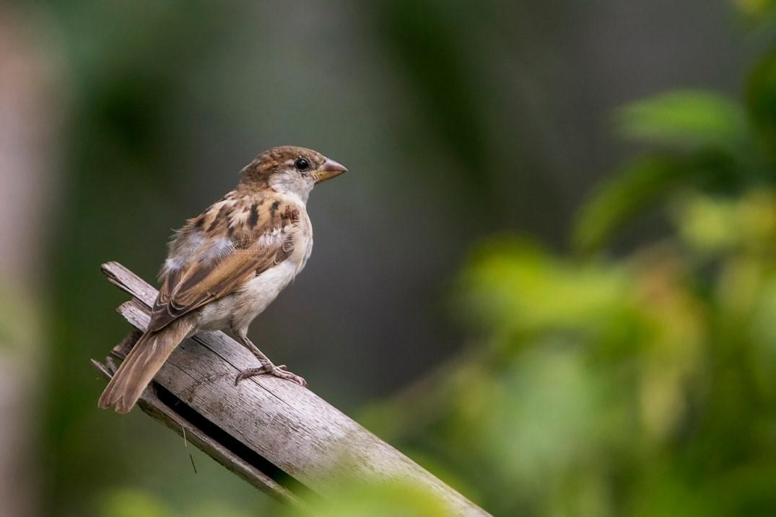
CHILDREN
This "passive immunization" usually lasts until children have built up their own defense system. Children develop their specific immune defense up to the age of about 10. And even after that, their defense system remains capable of learning throughout their lives when new pathogens appear.

Slide 125
Physician’s Wellbeing-ACP

Slide 126
Our Heroes, Our Frontline Fighters
Most Stressed Out

Slide 127
More than half (59.0%)had moderate to severe levels of perceived stress (PSSscores ≥14).
Stress (29.8 percent)
Anxiety symptoms (24.1 percent)
Depression (13.5 percent)
HCWs reported

Slide 128
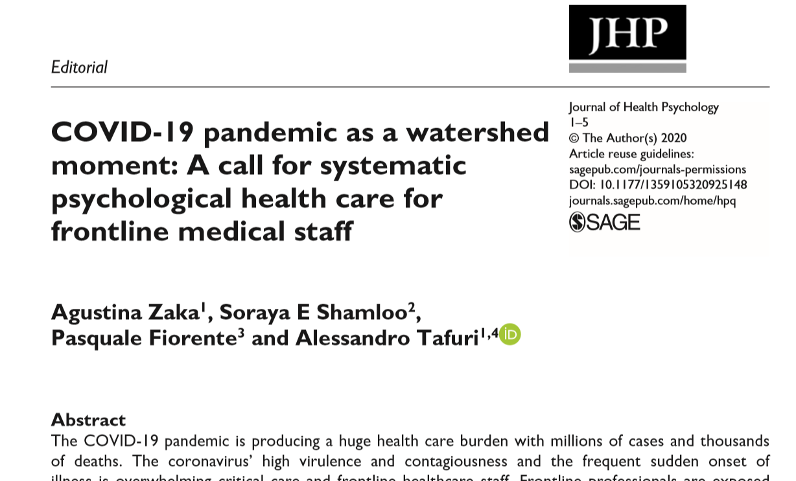

Slide 129
“there is no formula or operating manual for how to cope with the current global pandemic’’

Slide 130
Organizational Level
Instituitional Level
Individual Level

Slide 131
Organizational Level
স্বাস্থ্য বিভাগ
হাসপাতাল কতৃপক্ষ
Community Level
মিডিয়া
সাধারণ জনগন
সহকর্মী
Individual Level
Notes:
Listening to their anxieties, ensuring adequate protection, training health care professionals to provide appropriate care, supporting them and extending care to their families are important ways to help health professionals help others.

Slide 132
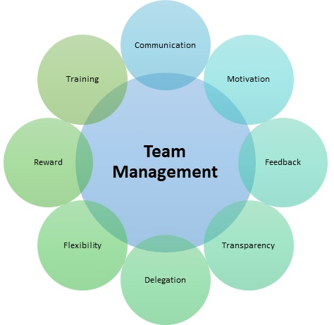
Organizational Level
টিম ম্যানেজারের দায়িত্ব
স্বাস্থ্যবিভাগ
হাসপাতালকতৃপক্ষ

Slide 133
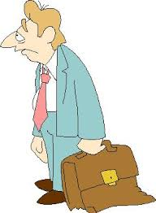
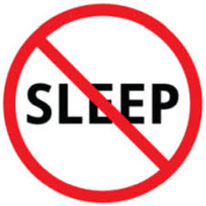
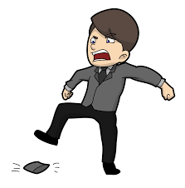
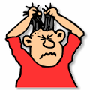
WARNING SIGN Being Extremely Stressed Out
Sadness, tearfulness,
or hopelessness
Being inactive,
lack of energy
Forgetful and
poor performance
Over eating
Difficulty sleeping
or changes in sleep
Mood swings
Trouble thinking
or making decisions
Irritability
Impaired concentration
Recurring nightmares
Notes:
Psychological distress and depression are the results of an intense or a continuous stress which has not been managed, mainly due to the individual’s difficulty to cope with stressful life events (Cummins et al., 2015; Drapeau et al., 2011; Marchand, 2004). The current pandemic is a source of intense stress for the whole world population.

Slide 134
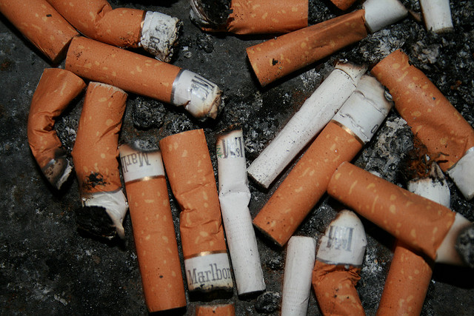
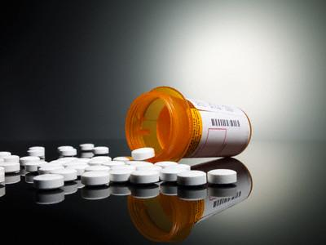
Unwanted Stress Reaction (Warning Signs)
Drug addiction,
Use of medication Excessive smoking

Slide 135
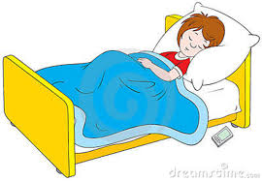

Slide 136
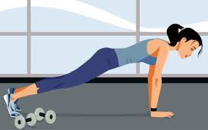
REGULAR EXERCISE
Relaxation

Slide 137
Ensure Breaks
Make Yourself
RELAXED

Slide 138
Improve Your COPING SKILL

Slide 139
দেখার দৃষ্টিভঙ্গী পরিবর্তণ করুন/ অন্যভাবে দেখুন (Change your PERCEPTION)
Perception
কঠিণ সময় বা সংকটের ‘ইতিবাচক’ দিকগুলোর দিকে মনোযোগ দিন

Slide 140
Unburden Yourself
Stressor control
STRESS

Slide 141
Relaxation
i. Breathing exercise (deep breathing)
Slowly breathe in from abdomen and then breath-out slowly for 10-15 times per sitting
ii. Meditation
Any spiritual activity

Slide 142
Indications for referral for mental health assessment
Expressing suicidal ideas
Violent/aggressive behaviour
Uncontrolled use of alcohol/drugs
Crying or expressing uncontrollable distress
Unexplained bizarre behaviour like talking or smiling to self
Significant deterioration in occupational functioning

Slide 143
Burn Out Depressed Doctors

Slide 144
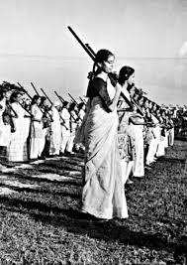
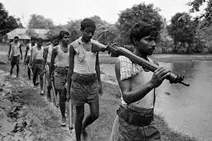
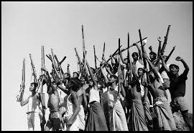
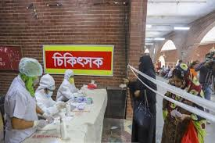
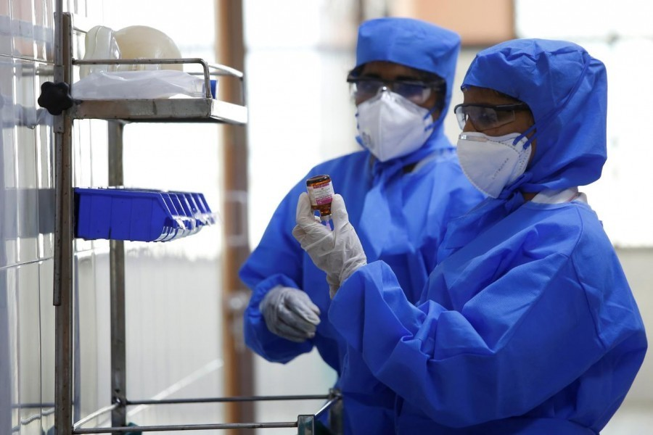
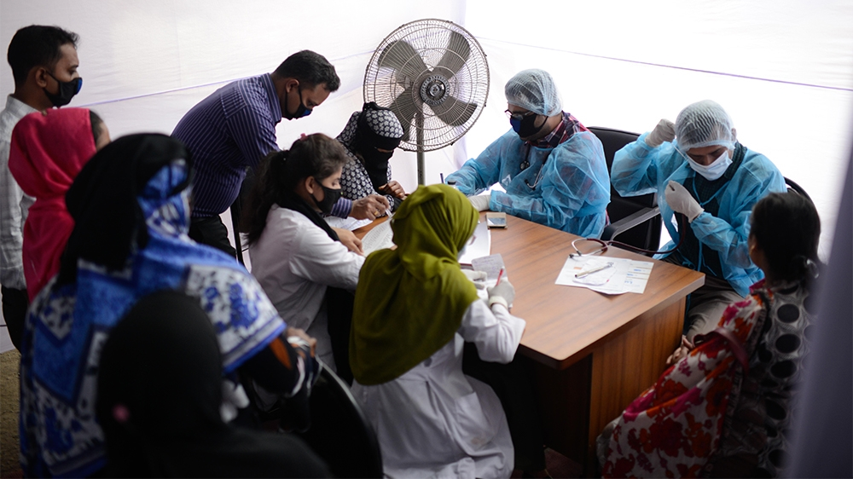
Notes:
এই দৃশ্য আমাদের গৌরবের ইতিহাস, মাথা নত করার দৃশ্য! এই ছবিগুলো আমাদের মনে করিয়ে দেয় একসময়ে দেশের টানে, কর্তব্যের টানে আমার দেশের দামাল ছেলেমেয়েরা হাতের কাছে যা কিছুই ছিলো তাই নিয়ে ঝাপিয়ে পড়েছিলো। বলা হয় ইতিহাস বার বার ফিরে ফিরে আসে। আবারো আমাদের যোদ্ধারা যা কিছুই আছে তাই নিয়ে ঝাপিয়ে পড়েছে।

Slide 146
Acknowledgement
Dr. Kaniz Fatema, Associate Professor , CCM,BIRDEM
Dr. Mekhala Sarker, Associate Professor, NIMH
Dr. Audry Rahman, AR, Medicine, PMCH

Slide 147
What you are doing for us is
JUST GREAT!
Notes:
আমাদের সম্মুখ সারির যোদ্ধাদের মানুশ হিসেবে একধাপ এগিয়ে থাকার জন্য অভিবাদন!

